Slide 1
Benchmarking selected European Airports by their Profitability Envelope – a Break-Even Analysis
Branko Bubalo
GAP Research Project
branko.bubalo@googlemail.com
GAB Final Project Meeting
Berlin, June 20th 2012

Slide 2
Contents
Introduction
Theoretical Background and Data description
Application of the maximum profitability envelope
Break-Even analysis
Conclusions and Outlook

Slide 3
Introduction
Results from benchmarking study on Norwegian airports
Extension and upgrade of GAP Database
Limited perspective on Profits (EBIT) and ratio ‘unit profits’ (EBIT per PAX) as one of the main chosen Partial Factor Productivity (PFP) indicators.
-> Intuition that this measure could be relevant and important, fuelled by pre-report of Ministry of Transportation in Norway (St.meld. nr. 48 [‘Report 48’]).
There exist certain alternatives, such as ‘EBITDA per WLU’ (Earnings before Interests, Taxes and Depreciation/Amortization per Workload Unit).
Notes:
Alternative measures EBIT, EBITDA, EBT, ROE, ROI etc.
PAX has been used because of clarity. Share of cargo on WLU is minimal (avg. <5%). Difficulties with incomparable cargo data.

Slide 4
Data: Total Costs and Revenues (log scale) and EBIT
Trends for 210 European airports over 9 years (2002 to 2010*)
*except for Italy &
France until 2009
Break-Even Points
(Source: Own illustration)
Notes:
Key factor for success is the right balance or adjustment of cost and revenue structure.
Nice correlations.
Two Break Even points:
Total Costs – Total Revenues (EBITDA) = 0
EBIT = 0

Slide 5
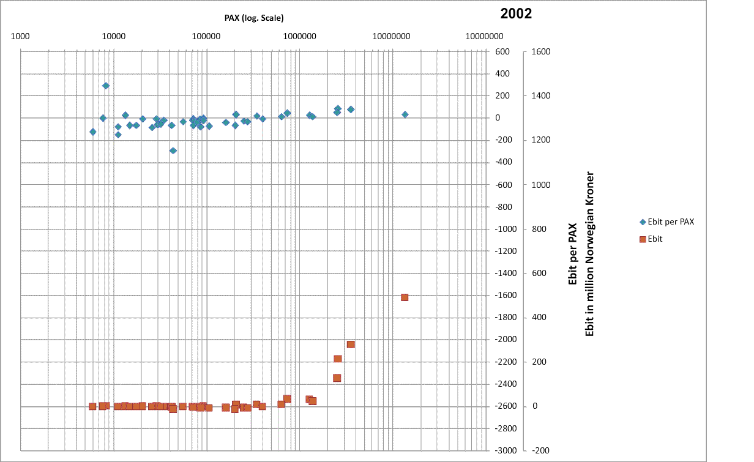
Animation of Ebit and Ebit per PAX over time in Norway
Critical Mass to make profits lies around 2 million PAX
Lower end of Airports has sharply increasing Losses per PAX
(Source: Own illustration)

Slide 6
Data points relative to the frontier and break-even line
“Keep it simple” approach:
(Source: Own illustration)

Slide 7
Algorithm:
i = 1 to n # n = Number of airports in the sample.
PAX_{i} < PAX_{i+1} < … < PAX_{n} # Sort PAX column in ascending order.
Envelope_{i} = EBIT per PAX_{i} # Initialize with first data point in ‘EBIT
# per PAX’; i = 1.
For i to n ≥ 2, # From the second entry onwards, the
Envelope_{i+1} = # new entry is compared, if larger than
# last Benchmark. If yes, it is set as new #‘EBIT per PAX’ Benchmark (Envelope).
Loop:
If EBIT per PAX_{i+1} > Envelope_{i}
Then EBIT per PAX_{i+1}
Else Envelope_{i}
(Source: Own illustration)
Notes:
Three columns:
EBIT per PAX
PAX
Envelope

Slide 8
Application of the Profitability Envelope on the dataset
Break-Even Point
(Source: Own illustration)
Notes:
Trend is obvious, but unable to find according best fitting function.
Application of Algorithm to draw maximum profitability frontier.

Slide 9
Profitability Envelope by year (even years 2002-2010)
(Source: Own illustration)
Notes:
Shift of curve:
Lower end (small airports) shifts downwards
Break-even point shifts right
Upper end (large airports) shifts upwards.

Slide 10
Break Even analysis
Cumulative EBIT and EBIT incl. efficiency gains for 140 Euro airports
Shift of Break-Even Point
Efficiency Gain
Shift of Break-Even point
(Source: Own illustration)

Slide 11
Conclusions
Maximum profitability envelope gives benchmarks relative to airport size without the need of arbitrary classifications.
Feasible Efficiency gains, by adjusting to best practices, are substantial.
Scenarios towards changes in Revenue/Cost structure can be quantified, e.g. in a cost-benefit analysis (CBA) regarding changes in Airport Charges scheme.

Slide 12
Thank you for your attention! Questions?
Suggestions and Comments are welcome.
branko.bubalo@googlemail.com
www.gap-projekt.de

